Slide 1
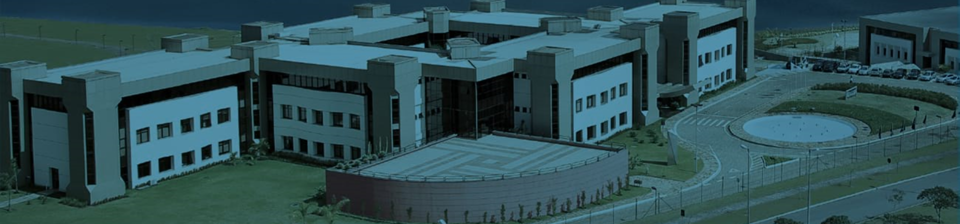
FUNDAÇÃO DOM CABRAL LIBRARIES
2019

Slide 2

OUR LIBRARIES
The Fundação Dom Cabral Library System is composed by the libraries of the campuses Nova Lima and Belo Horizonte.
Our book collection has over 40.000 items.
It also has magazines, newspapers and offers access to 07 data bases.
The collection covers mostly Business topics.

Slide 3



DATA BASES
PEARSON VIRTUAL LIBRARY
EBSCO
EMIS

Slide 4



DATA BASES
MINHA BIBLIOTECA
COMDINHEIRO
PRESSREADER

Slide 5



DATA BASES
OXFORD HANDBOOKS ONLINE
OXFORD SCHOLARSHIP ONLINE
PORTAL DE PERIÓDICOS CAPES

Slide 6
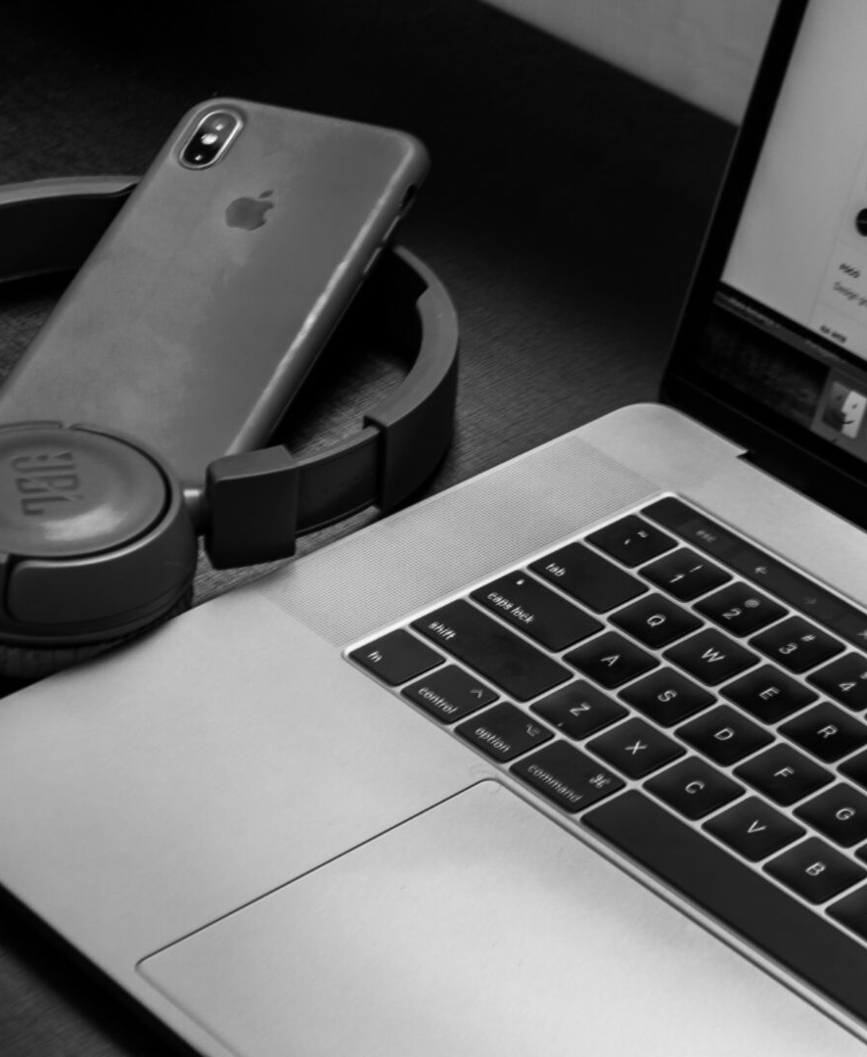
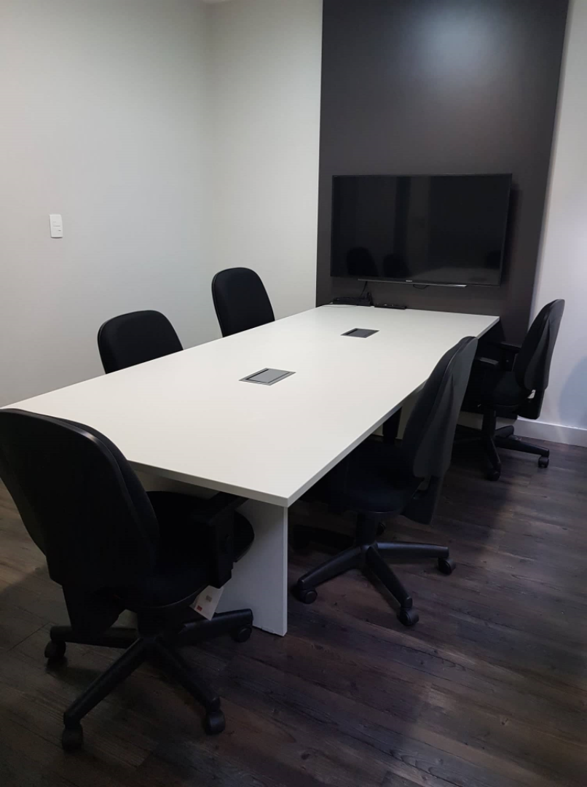
STUDY ROOMS
  04 study rooms with internet access available for students;
  02 of the study rooms are adapted for video conferences.

Slide 7
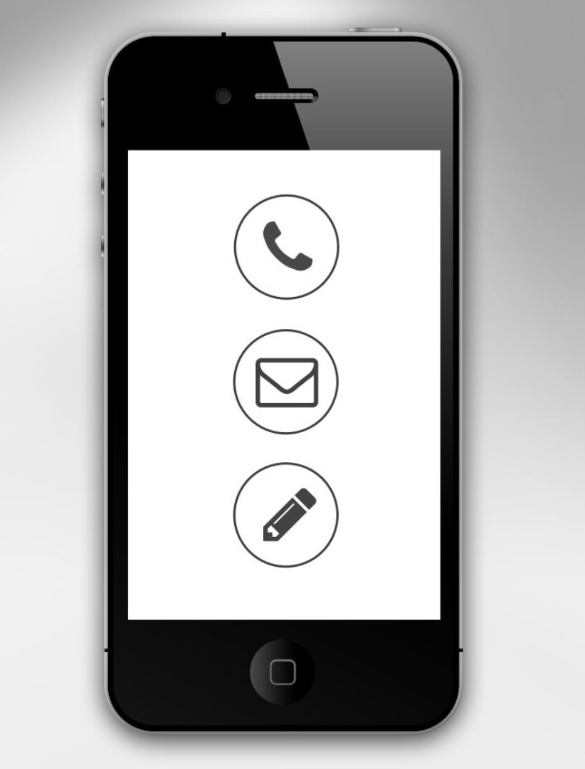
BUSINESS HOURS
CONTACT US
Belo Horizonte:
Monday to Friday:
8:30 am - 9:30 pm
Saturday:
8:00 am - 2:00 pm
Nova Lima:
Monday to Friday:
08:30 am - 05:30 pm
E-MAIL ADDRESS
biblioteca@fdc.org.br
PHONE NUMBER
(31) 3589-7297 / (31) 3589-7413 – Nova Lima
(31) 3299-9852 / (31) 3299-9732 – Belo Horizonte
WHATSAPP
+55 31 8872-4298

